Slide 1
Fundamentals of Software Project Management (FSPM)
Instructor: Iqra Fahad
(School of Computing)
National University- FAST (KHI Campus)

Slide 2


Week 1

Slide 3
Books
🠶 Text Book:
🠶 Software Project Management: A Practitioner's Approach, E. M. Bennatan, ISSBN: 978-0077076481, McGraw-Hill Book Company
🠶 Reference Books:
🠶 Applied Software Project Management, Andrew Stellman, Jennifer Greene,
ISBN: 978-0596009489, O'Reilly Media.
🠶 A Guide to the Project Management Body of Knowledge (PMBOK® Guide), 7th edition, Project Management Institute (PMI).
🠶 Agile Practice Guide, Project Management Institute (PMI).

Slide 4
Marks Distribution
🠶 Assignments | 05 %
🠶 Quizzes | 05 %
🠶 Report | 10 %
🠶 Mid Exam | 30 % (15% each)
🠶 Final Exam | 50 %

Slide 5
Course Contents
Week | Topics
1 | Initiation Phase. Introduction to Project management
2 | Project management in organizations
3 | Process Groups
 | Integration Management
4 | Scope Management
5 | Schedule (Time) Management
 | MIDTERM EXAM 1
7 | Cost Management
8 | Quality Management
9 | Resource Management
10 | Communication Management
11 | Risk Management
 | MIDTERM EXAM 2
13 | Procurement Management
14 | Stakeholder Management
15 | Professional Management
16 | Revision
17 | FINAL EXAM

Slide 6
Initiation
🠶 IT professionals (geeks) are qualified and competent Information Technology (IT) professionals into leadership positions.
🠶 Some Properties:
🠶 tough minded,
🠶 open to new ideas, and
🠶 customer-service orientation
🠶 The work we do improves lives

Slide 7
Selecting a Geek Leader
🠶 They are promoted .
🠶 Selection Criteria:
Does the geek have courage: Leaders need the mental and moral strength to take reasonable risks, persist during difficult times, and endure when situations seem difficult or dangerous.
Does the geek communicate well?
Is the geek proactive? understand their priorities, take action to obtain realistic goals in a proactive manner
Deming Cycle (Plan, Do, Check, Act)
Is the geek capable of establishing and pursuing a unified vision? align their team’s tasks
with the organization’s business objectives
Is the geek accountable? (Document, Train, Measure, Praise)
Does the geek have personal credibility? Leaders need to be believable. They need the respect and trust of their customers, their managers, their peers, and their team members. He must be honest.

Slide 8
Selecting a Geek Leader (cont…)
Is the geek trustworthy and reliable?
Does the geek manage feelings? Leaders must be emotionally intelligent; they must
be aware of their own feelings and their impact on the people around them.
Does the geek lead by example?
Can the geek manage risk?
Is the geek a problem solver?
Is the geek capable of continuously improving processes?
Does the geek balance work and life priorities?

Slide 9
The Geek Leadership Challenge
“In that day you will be like a man who runs from a lion, only to meet a bear. Escaping from the bear, he leans his hand against a wall in his house and he’s bitten by a snake”

Slide 10
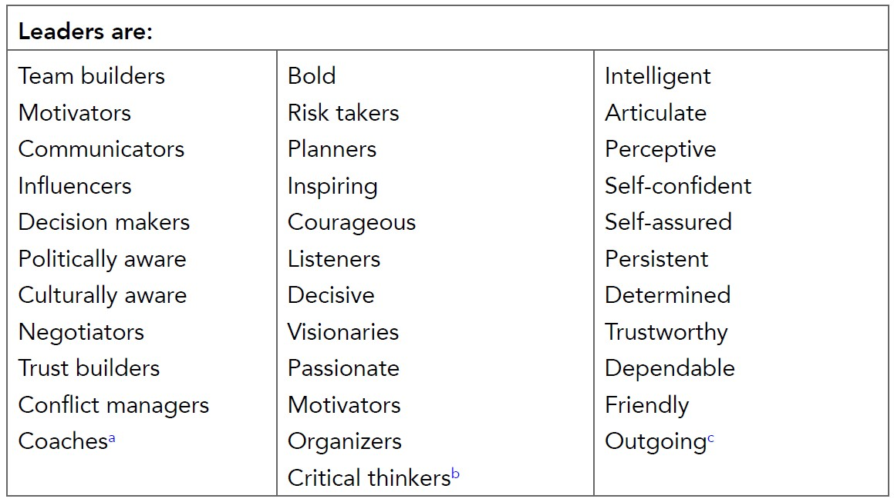
Leadership Attributes

Slide 11
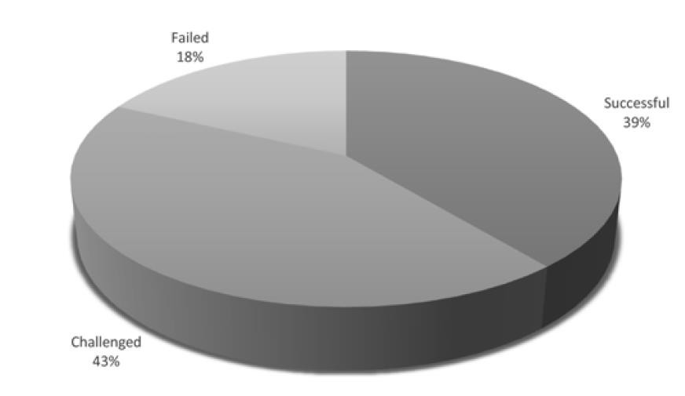
IT Projects outcome

Slide 12
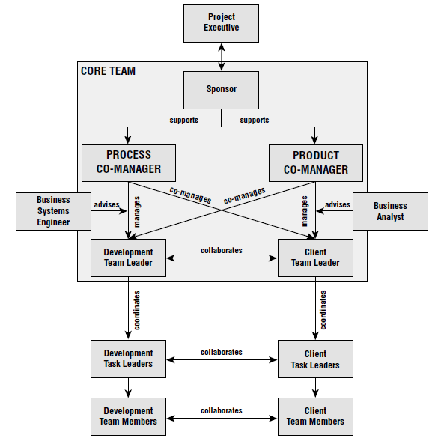
Effective Complex Project Management (ECPM) Framework

Slide 13
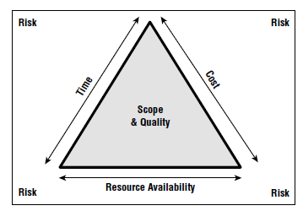
Scope Triangle

Slide 14
“Tip”
🠶 “ Work Smart, not hard”

Slide 15
What is SPM?
🠶 Maintain flow
🠶 Manage outcomes (Deliverables)
🠶 Use tools and techniques
🠶 Improve operation
🠶 New requirement
🠶 Aim is to achieve all the objectives remaining in its define constraint
🠶 Time
🠶 Cost
🠶 Scope

Slide 16
Project Vs Process (Operation)
🠶 Definite time
🠶 Resources
🠶 Budget
🠶 Deliverable parameters
🠶 Has an end
🠶 Need to update an operation (Operation) that result in some deliverable.

Slide 17

People ( Resource)

Slide 18

International Business Environment

Slide 19
PM Processes
🠶 Initiating Process Group
🠶 Planning Process Group
🠶 Executing Process Group
🠶 Monitoring Process Group
🠶 Closing Process Group

Slide 20
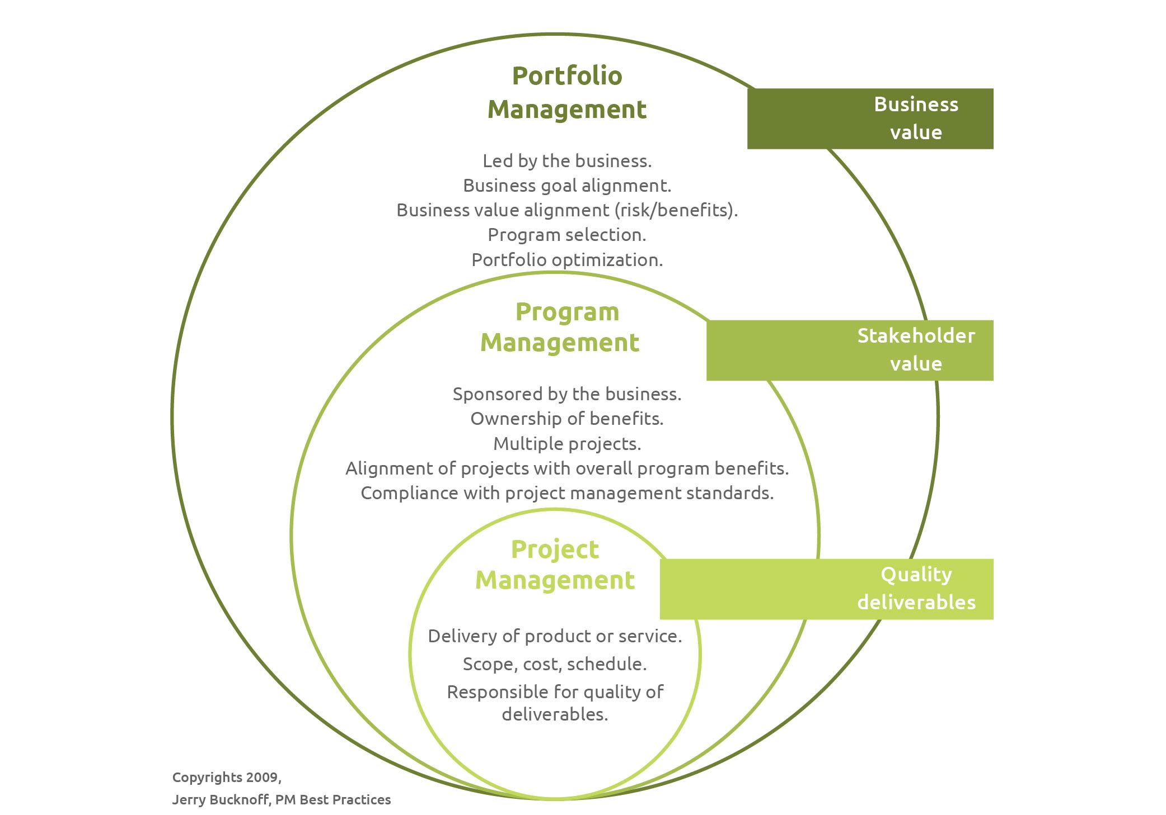

Slide 21
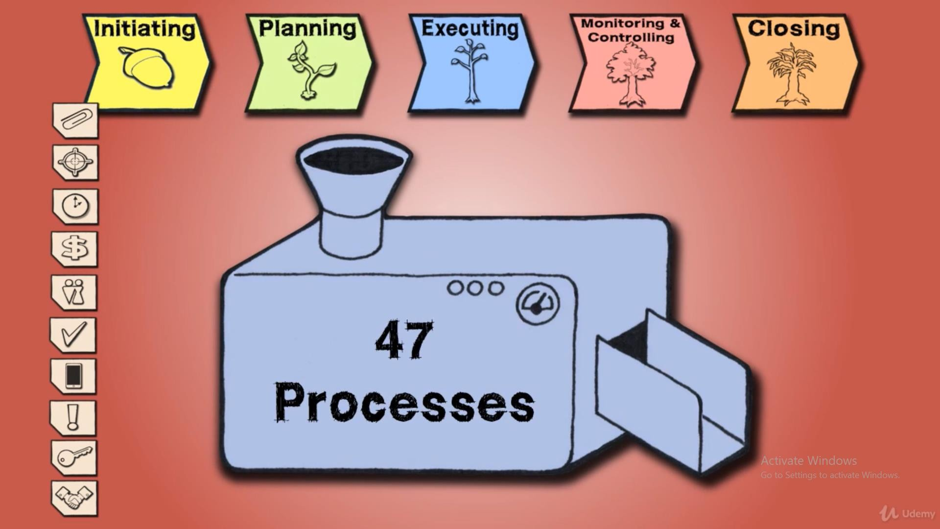
Project Management Matrix
Integration Scope
Time
Cost HR
Quality Communication Risk Procurement
Stakeholder Mang.

Slide 22
Portfolio, Program and PM
Portfolio
🠶 Portfolio is a collection of program.
🠶 May or may not be related
🠶 Still part of Organizational goal
🠶 Org. maintains a portfolio of all the programs in order to meet its strategic business goals.
🠶 It handles the governance of Project life cycle
🠶 It maintains the program’s standards, document repository and any portfolio management tools.

Slide 23
Program
🠶 Program is a related group of projects.
🠶 They are grouped to achieve a Org. goal.
🠶 Categorized work into smaller sets of related projects.
🠶 May be done sequentially or parallel

Slide 24
Project
🠶 Is temporary
🠶 Produce a deliverable, service or result
🠶 A new work in organization
🠶 Organization combine portfolio, program and project in one umbrella
known as :
“Organizational Project Management”

Slide 25
Role of PM
🠶 Leadership
🠶 Motivation
🠶 Team building
🠶 Negotiation
🠶 Conflict management

Slide 26
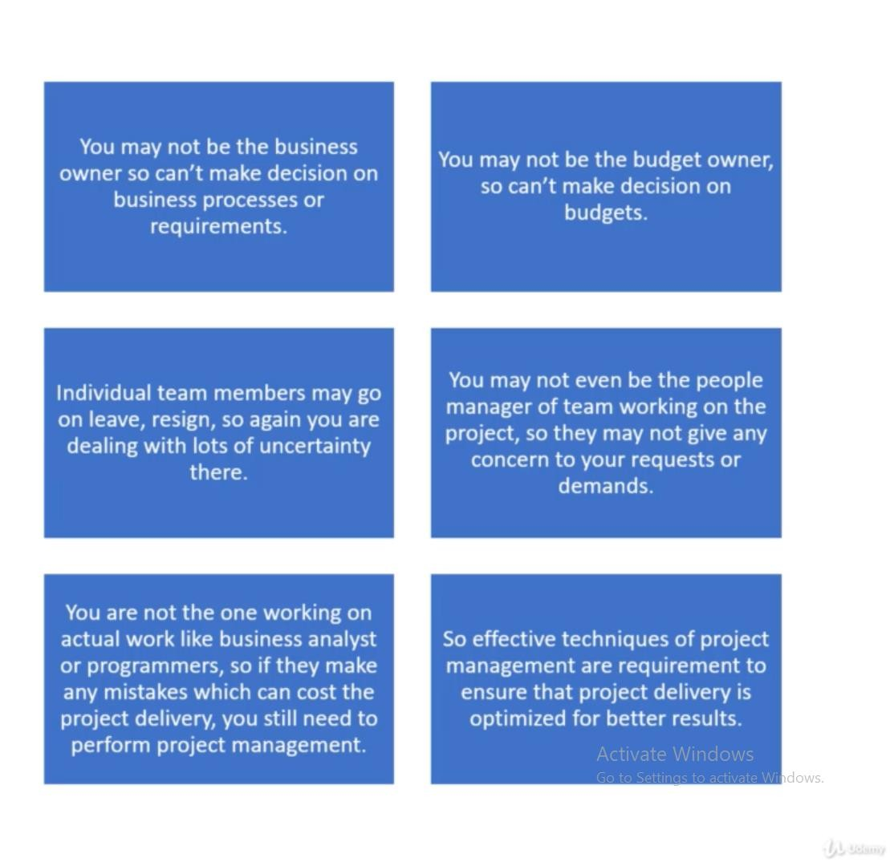
Common Challenges

Slide 27
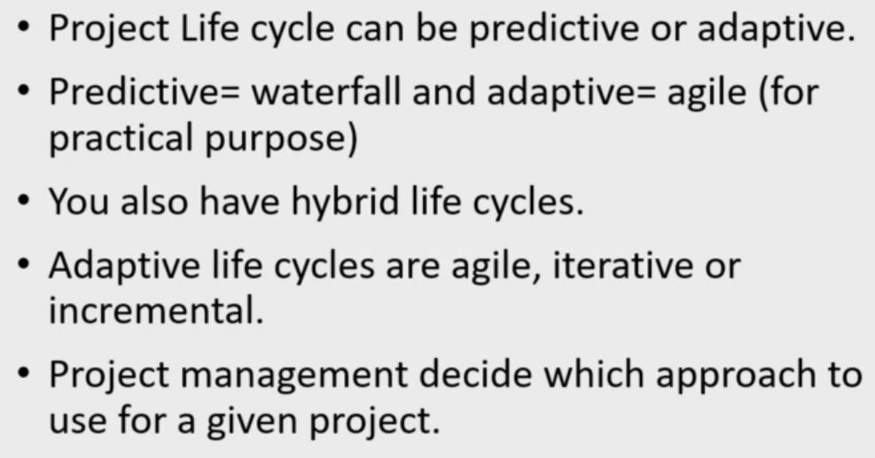
Project life cycle

Slide 28
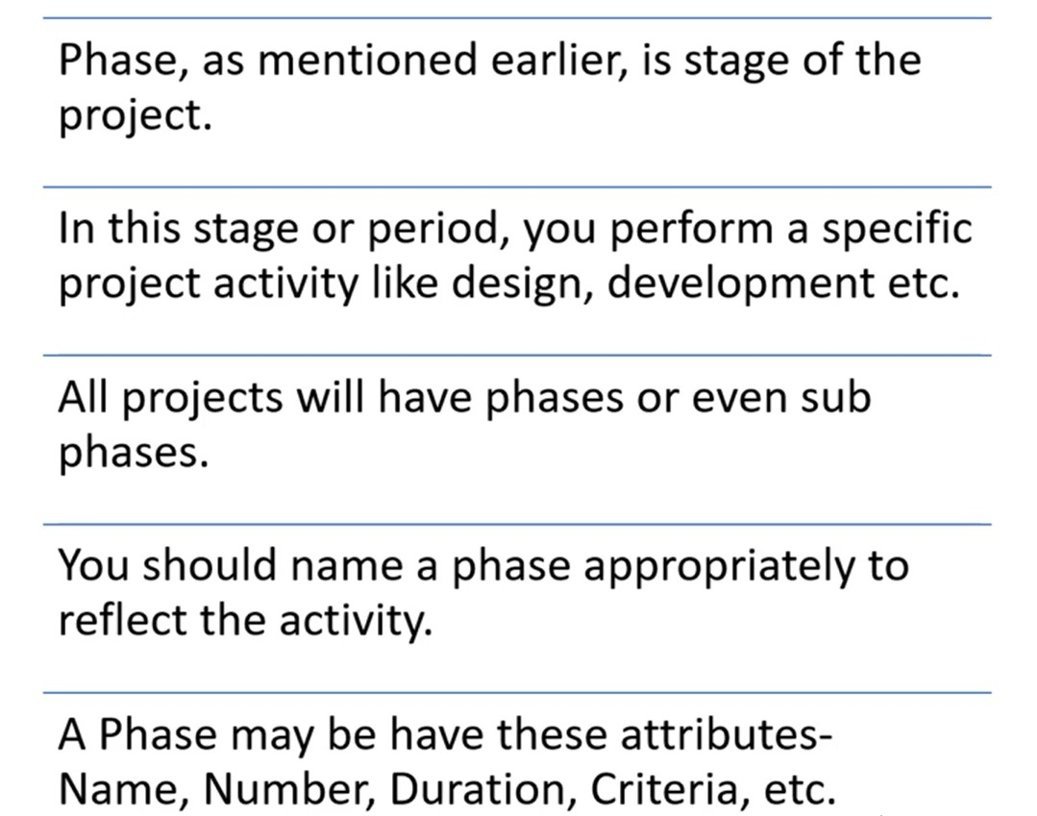
Documenting Phases

Slide 29
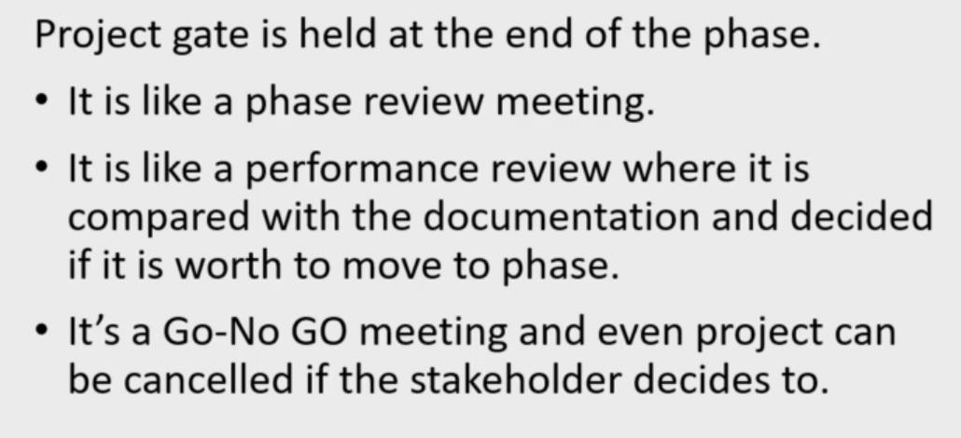
Project/Phase Gate

